Slide 1
GREEN HOUSE MONITORING SYSTEM
USING ARDUINO UNO

Slide 2
Presented By
Rakib Hasan (1801047)
Md. Sakibul Alam Sakib (2001032)
Fardin Ahmed Ashan (2001033)
Shimul Mahmud Khatami (2001037)

Slide 3
Introduction
The greenhouse monitoring system is designed to revolutionize agricultural practices by
offering real-time insights into environmental conditions within controlled growing
environments.
This system aims to optimize crop cultivation, minimize resource wastage, and enhance
overall productivity.

Slide 4
Objectives:
To enhance agricultural productivity.
To optimize resource usage such as water or energy.
To minimize crop losses .
To enable remote monitoring.
To promote sustainability.

Slide 5
Sensors
-Used to read data from the environment.
Soil Moisture Sensor
Humidity sensor
Temperature sensor
Light Sensor (photo register sensor-KY-018)x

Slide 6
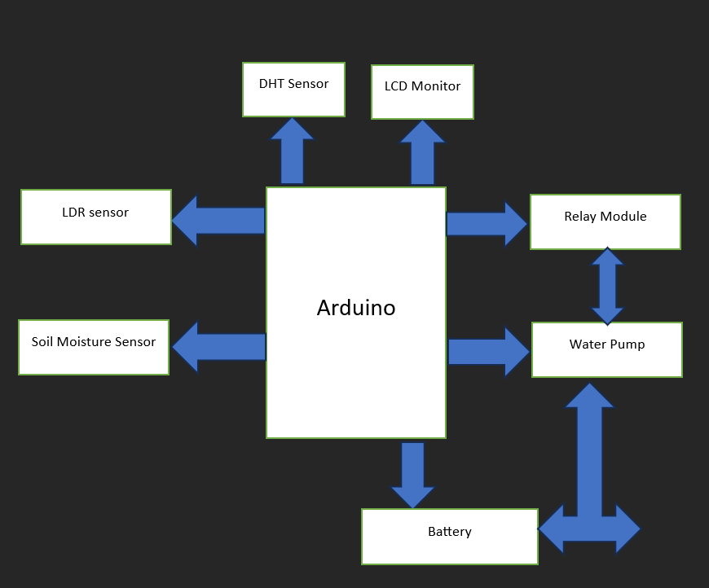
Block Diagram

Slide 7
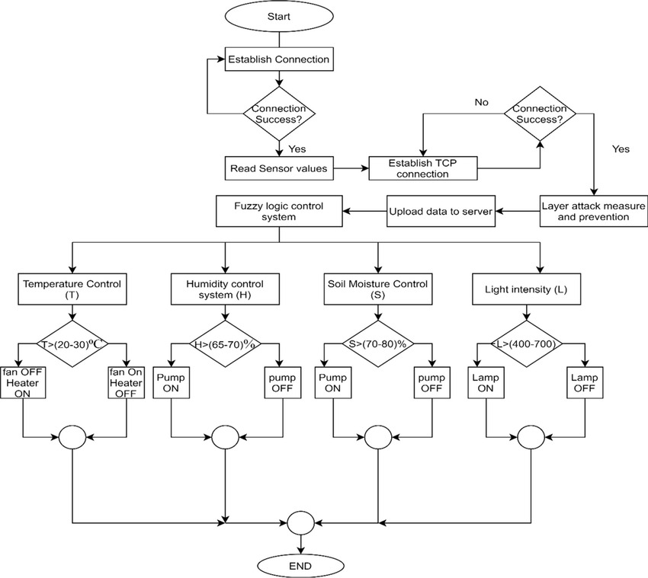
Flow Chart

Slide 8
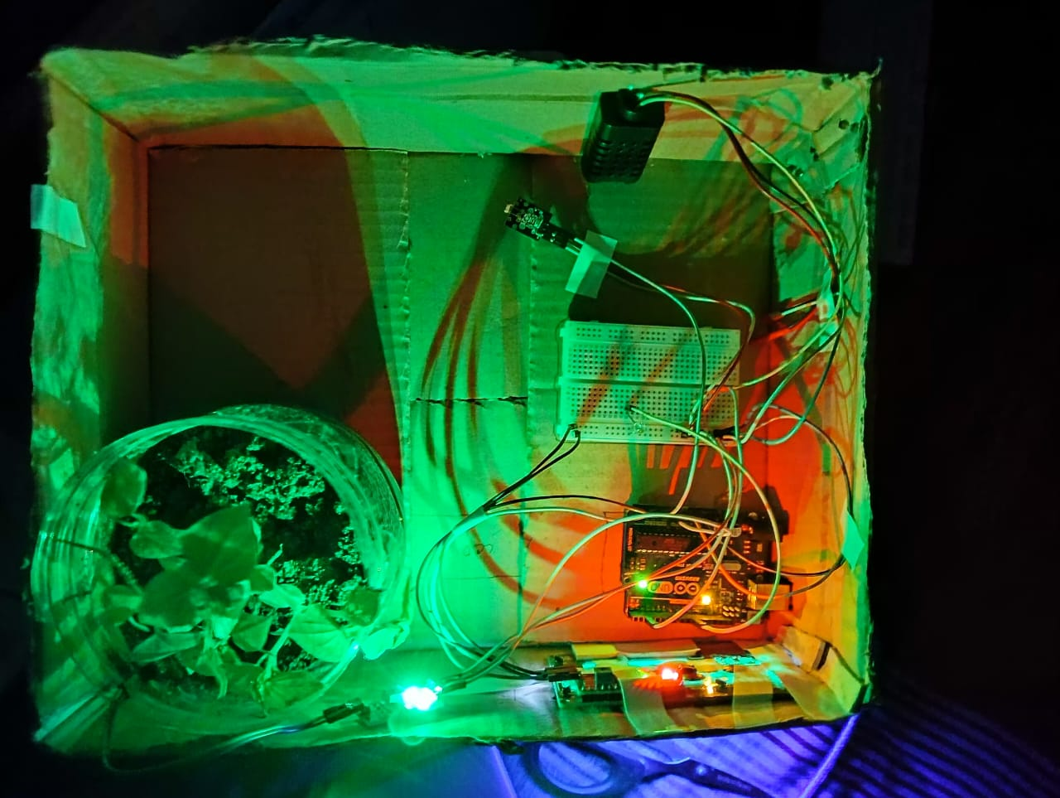
Working progress

Slide 9
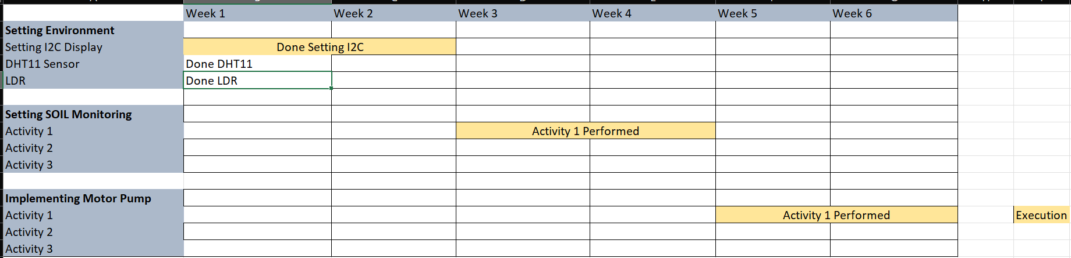
Gantt Chart

Slide 10
Thank you

